Slide 1

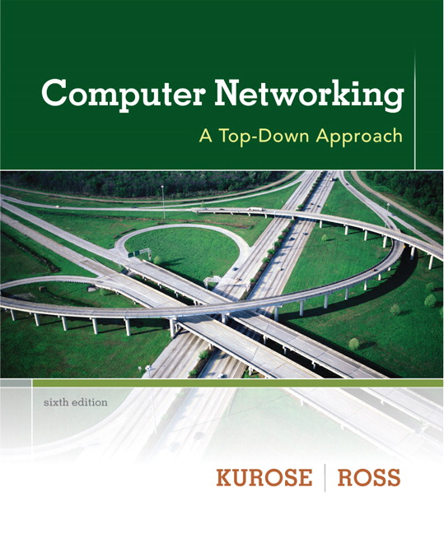
Chapter 4: Network Layer
Computer Networking: A Top-Down Approach 6th edition Jim Kurose, Keith Ross Addison-Wesley

Slide 2
Outline
4. 1 Introduction
4.2 Virtual circuit and datagram networks
4.4 IP: Internet Protocol
Datagram format
IPv4 addressing
IPv6
4.5 Routing algorithms
Link state
Distance Vector
Hierarchical routing

Slide 3
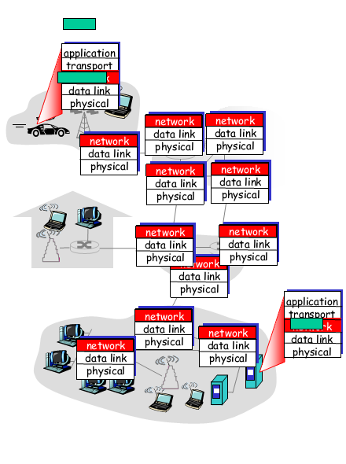
Network layer
transport segment from sending to receiving host
on sending side encapsulates segment into datagrams
on receiving side, delivers segments to transport layer
network layer protocols in every host, router
router examines header fields in all IP datagrams passing through it

Slide 4
Two Key Network-Layer Functions
Forwarding: move
packets from router’s
input to appropriate
router output
Routing: determine
route taken by
packets from source
to dest.
* routing algorithms
analogy:
Routing: process of
planning trip from
source to dest
Forwarding: process
of getting through
single interchange

Slide 5
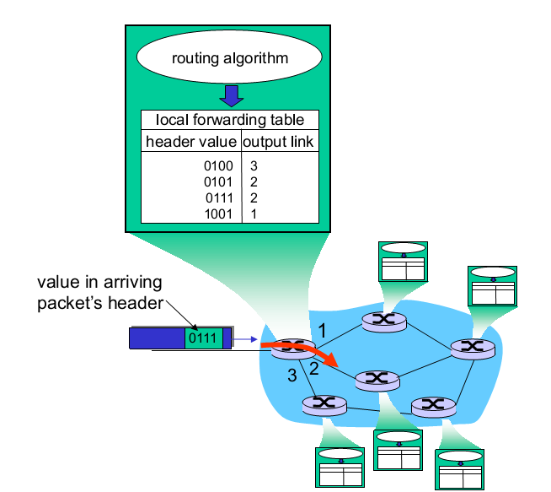
Interplay between routing and forwarding

Slide 6
Outline
4. 1 Introduction
4.2 Virtual circuit and datagram networks
4.4 IP: Internet Protocol
Datagram format
IPv4 addressing
IPv6
4.5 Routing algorithms
Link state
Distance Vector
Hierarchical routing

Slide 7
Network layer connection and connection-less service
datagram network provides network-layer
connectionless service
VC network provides network-layer
connection service
analogous to the transport-layer services,
but:
service: host-to-host
no choice: network provides one or the other
implementation: in network core

Slide 8
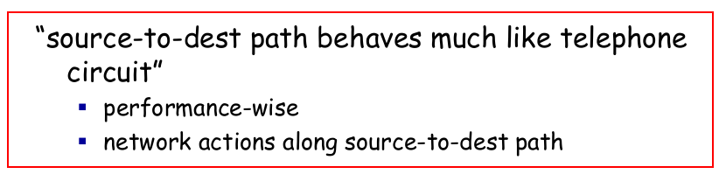
Virtual circuits
Call setup, teardown for each call before data can flow
each packet carries VC identifier (not destination host address) every router on source-dest path maintains “state” for each passing connection
link, router resources (bandwidth, buffers) may be allocated to VC (dedicated resources = predictable service) “source-to-dest path behaves much like telephone circuit”
performance-wise
network actions along source-to-dest path

Slide 9
VC implementation
a VC consists of:
1. path from source to destination
2. VC numbers, one number for each link along
path
3. entries in forwarding tables in routers along
path
packet belonging to VC carries VC number (rather than dest address)
VC number can be changed on each link.
New VC number comes from forwarding table

Slide 10
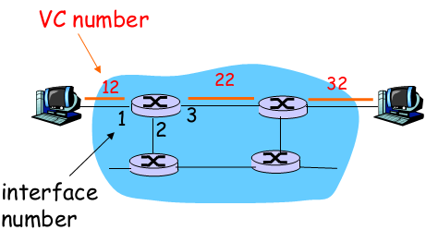
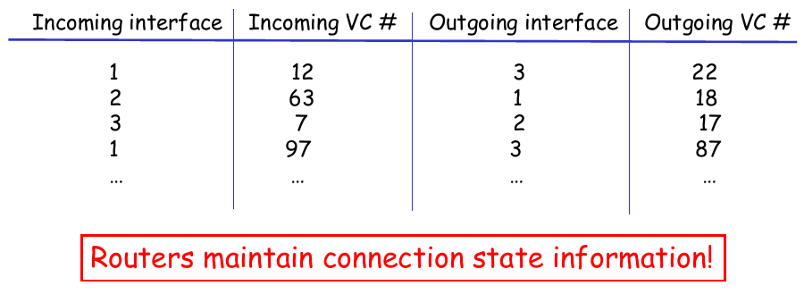
VC Forwarding table
Forwarding table in
northwest router:

Slide 11
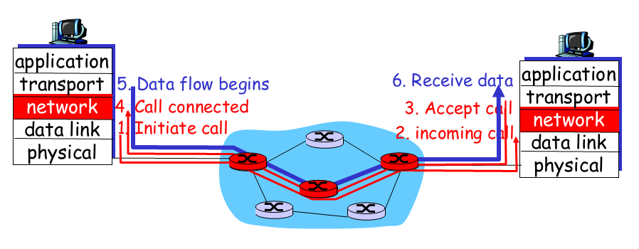
Virtual circuits: signaling protocols
used to setup, maintain teardown VC
used in ATM, frame-relay, X.25
not used in today’s Internet

Slide 12
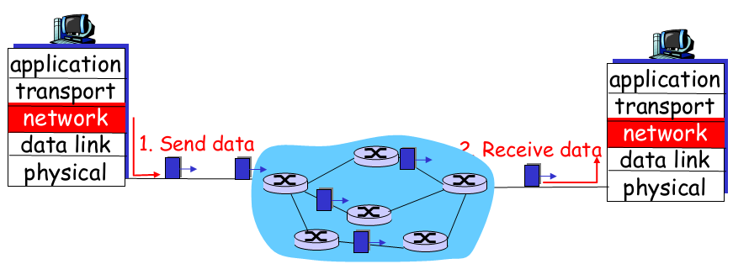
Datagram networks
no call setup at network layer
routers: no state about end-to-end connections
no network-level concept of “connection”
packets forwarded using destination host address
packets between same source-dest pair may take different paths

Slide 13
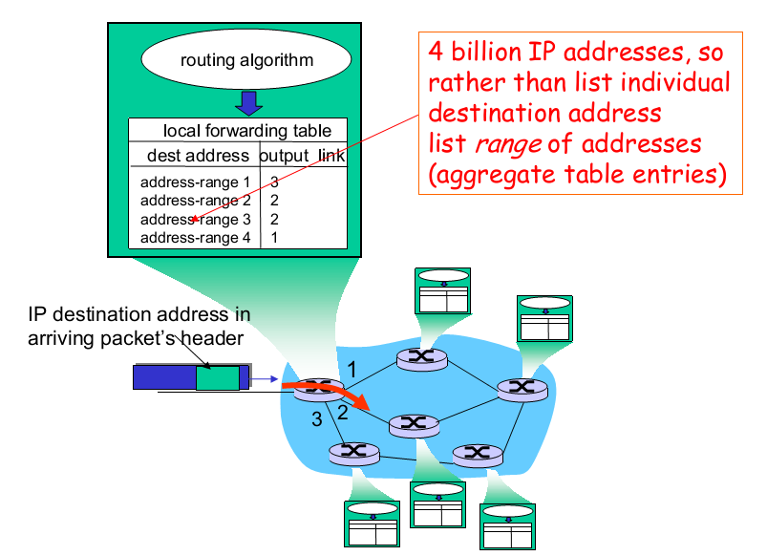
Datagram Forwarding table

Slide 14
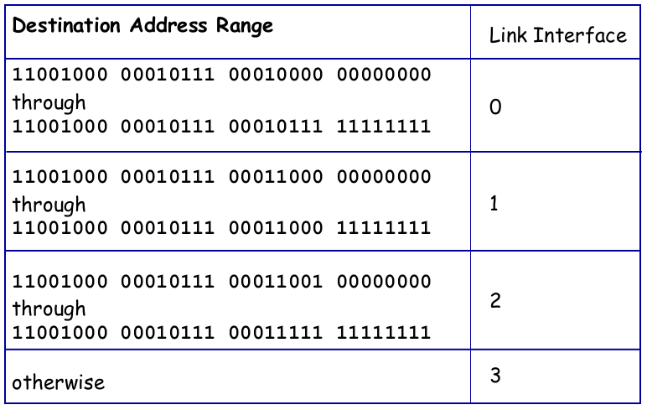
Datagram Forwarding table
Q: but what happens if ranges don’t divide up so nicely?

Slide 15
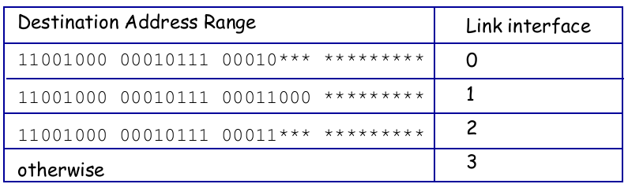
Longest prefix matching
when looking for forwarding table entry for given destination address, use longest address prefix that matches destination address.
Examples: Which interface?
DA: 11001000 00010111 00011000 10101010
DA: 11001000 00010111 00010110 10100001

Slide 16
Outline
4.1 Introduction
4.2 Virtual circuit and datagram networks
4.4 IP: Internet Protocol
Datagram format
IPv4 addressing
IPv6
4.5 Routing algorithms
Link state
Distance Vector
Hierarchical routing

Slide 17
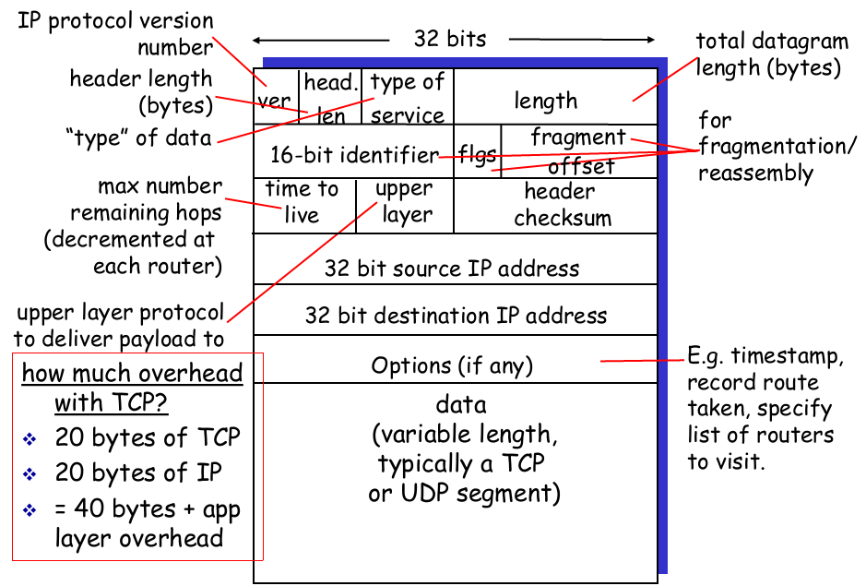
IP datagram format

Slide 18
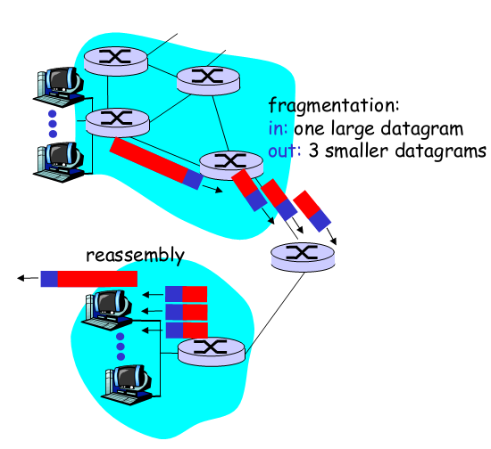
IP Fragmentation & Reassembly
network links have MTU (max.transfer size) - largest possible link-level frame.
different link types, different MTUs
large IP datagram divided (fragmented) within net
one datagram becomes several datagrams
“reassembled” only at final destination
IP header bits used to identify, order related fragments

Slide 19
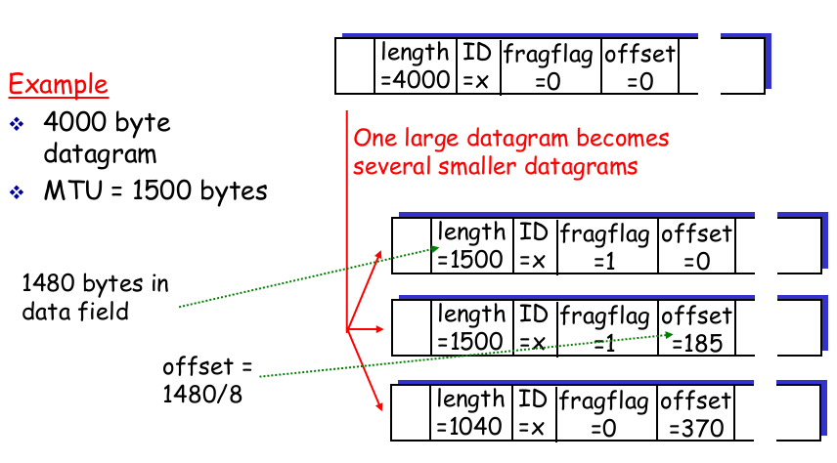
IP Fragmentation and Reassembly

Slide 20
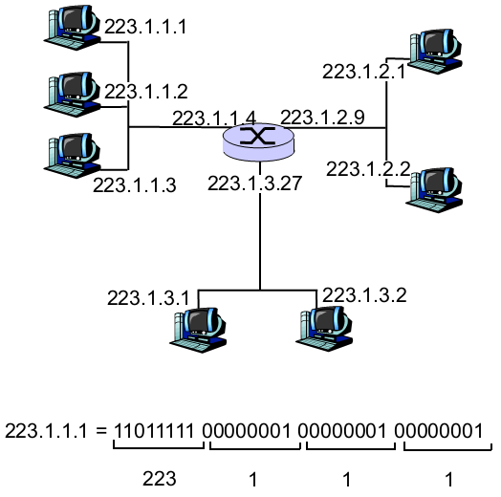
IP Addressing: introduction
IP address: 32-bit identifier for host, router interface
interface: connection between host/router and physical link
router’s typically have multiple interfaces
host typically has one interface
IP addresses associated with each interface

Slide 21
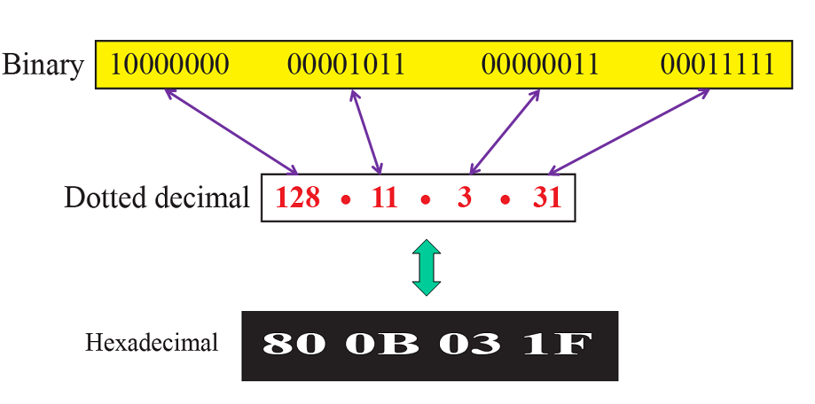
Network layer

Slide 22
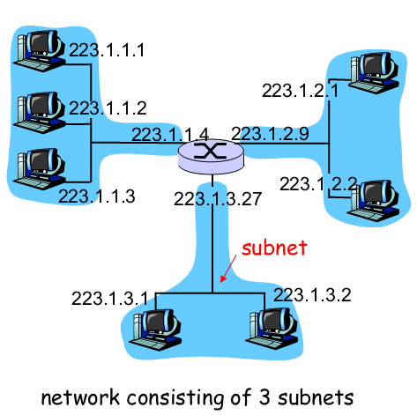
Subnets
❖ IP address:
▪ subnet part (high
order bits)
▪ host part (low order
bits)
❖ What’s a subnet ?
▪ device interfaces with
same subnet part of IP
address
▪ can physically reach
each other without
intervening router

Slide 23
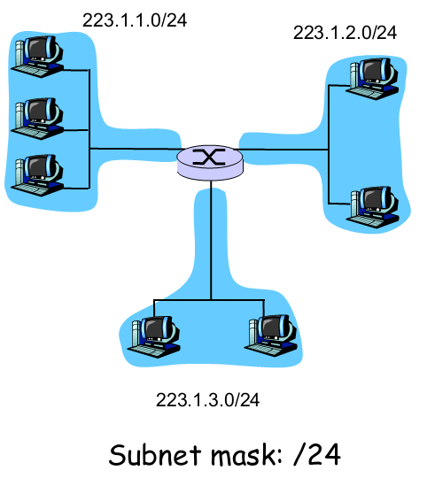
Subnets
Recipe to determine the subnets, detach each interface from its host or router, creating islands of isolated networks, each isolated network is called a subnet.

Slide 24
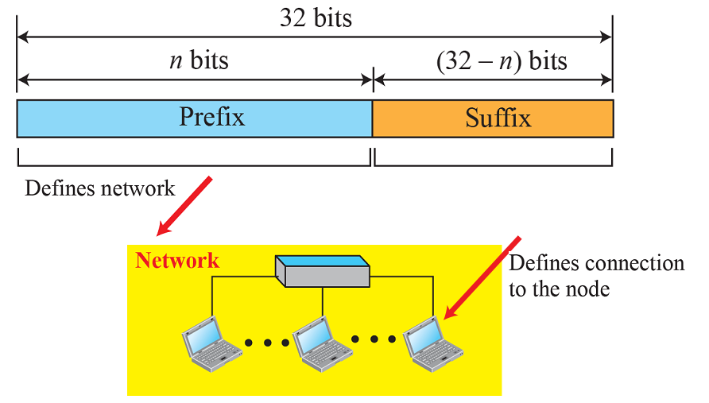
Subnets

Slide 25
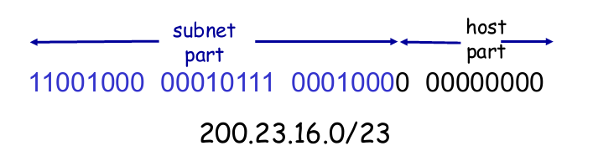
IP addressing: CIDR
CIDR: Classless InterDomain Routing
▪ subnet portion of address of arbitrary length
▪ address format: a.b.c.d/x, where x is # bits in
subnet portion of address

Slide 26
IP addresses: how to get one?
Q: How does a host get IP address?
❖ hard-coded by system admin in a file
▪ Windows: control-panel->network->configuration->tcp/ip->properties
▪ UNIX: /etc/rc.config
❖ DHCP: Dynamic Host Configuration Protocol:
dynamically get address from as server
▪ “plug-and-play”

Slide 27
IP addresses: how to get one?
Q: How does network get subnet part of IP addr?
A: gets allocated portion of its provider ISP’s address space
ISP's block 11001000 00010111 00010000 00000000 200.23.16.0/20
Organization 0 11001000 00010111 00010000 00000000 200.23.16.0/23
Organization 1 11001000 00010111 00010010 00000000 200.23.18.0/23
Organization 2 11001000 00010111 00010100 00000000 200.23.20.0/23
... ….. …. ….
Organization 7 11001000 00010111 00011110 00000000 200.23.30.0/23

Slide 28
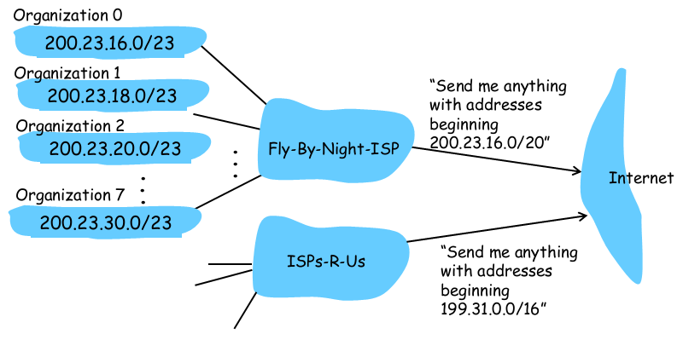
Hierarchical addressing: route aggregation
Hierarchical addressing allows efficient advertisement of routing information:

Slide 29
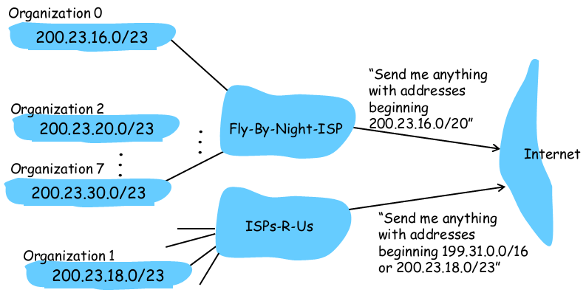
Hierarchical addressing: more specific routes
ISPs-R-Us has a more specific route to Organization 1

Slide 30
IP addressing: the last word...
Q: How does an ISP get block of addresses?
A: ICANN: Internet Corporation for Assigned Names and Numbers
allocates addresses
manages DNS
assigns domain names, resolves disputes

Slide 31
IPv6
Initial motivation: 32-bit address space soon
to be completely allocated.
Additional motivation:
header format helps speed processing/forwarding
header changes to facilitate QoS
IPv6 datagram format:
fixed-length 40 byte header
no fragmentation allowed

Slide 32
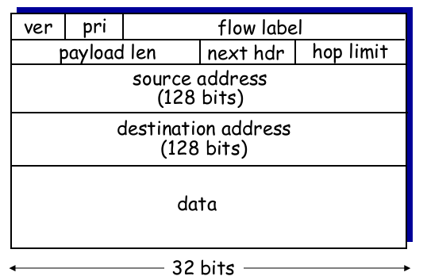
IPv6 Header (Cont)
Priority: identify priority among datagrams in flow
Flow Label: identify datagrams in same “flow.”
(concept of“flow” not well defined).
Next header: identify upper layer protocol for data

Slide 33
Other Changes from IPv4
Checksum: removed entirely to reduce processing time at each hop
Options: allowed, but outside of header, indicated by “Next Header” field
ICMPv6: new version of ICMP
additional message types, e.g. “Packet Too Big”
multicast group management functions

Slide 34
Transition From IPv4 To IPv6
Not all routers can be upgraded simultaneous
no “flag days”
How will the network operate with mixed IPv4 and IPv6 routers?
Tunneling: IPv6 carried as payload in IPv4 datagram among IPv4 routers

Slide 35
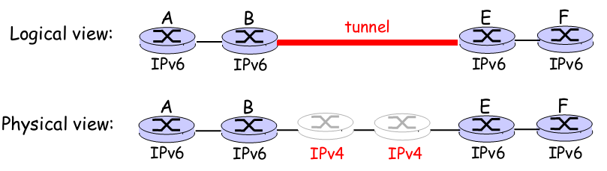
Tunneling

Slide 36
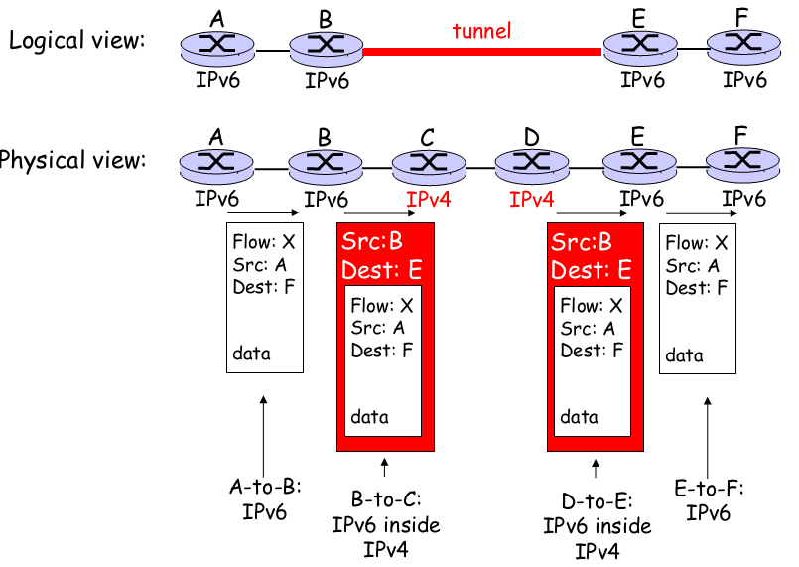
Tunneling

Slide 37
Outline
4.1 Introduction
4.2 Virtual circuit and datagram networks
4.4 IP: Internet Protocol
Datagram format
IPv4 addressing
IPv6
4.5 Routing algorithms
Link state
Distance Vector
Hierarchical routing

Slide 38
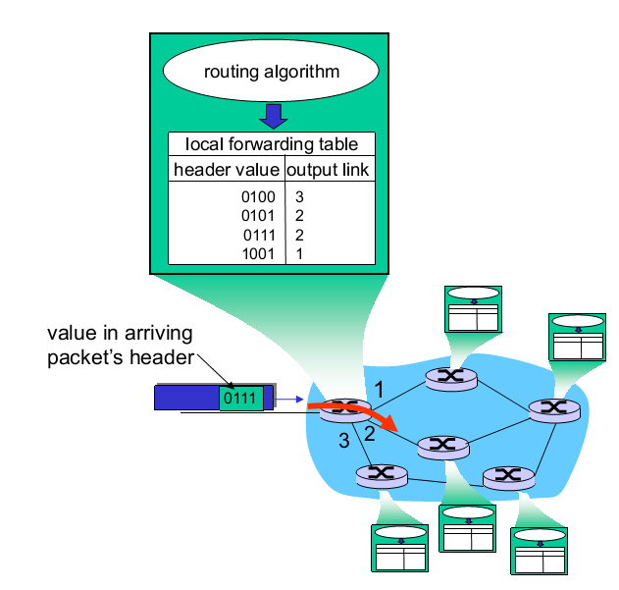
Interplay between routing, forwarding

Slide 39
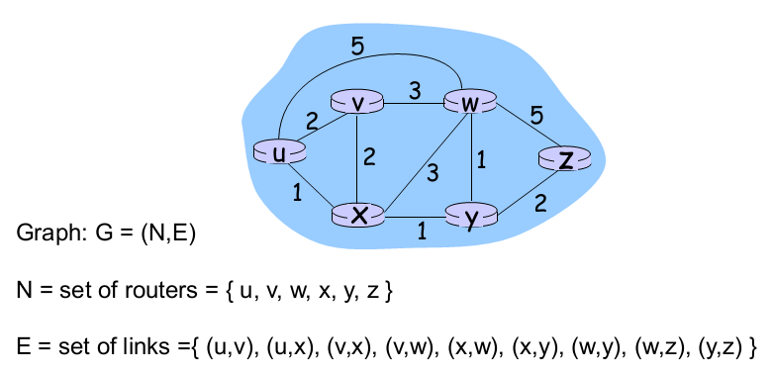
Graph abstraction
Remark: Graph abstraction is useful in other network contexts
Example: P2P, where N is set of peers and E is set of TCP connections

Slide 40
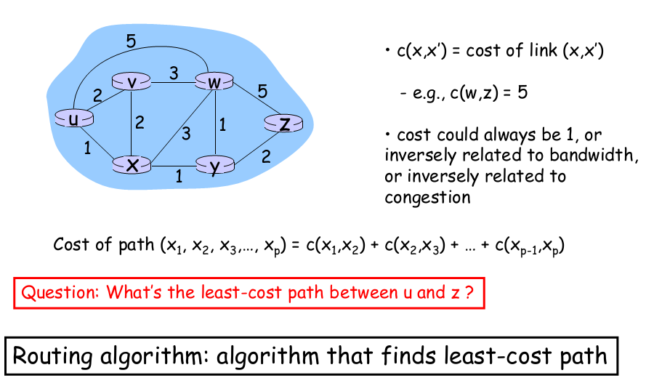
Graph abstraction: costs

Slide 41
Routing Algorithm classification
Global or decentralized information?
Static or dynamic?
Global:
❖ all routers have complete
topology, link cost info
❖ “link state” algorithms
Decentralized:
❖ router knows physically-connected neighbors, link
costs to neighbors
❖ iterative process of
computation, exchange of
info with neighbors
❖ “distance vector” algorithms
Static: routes change slowly over time
Dynamic: routes change more quickly
periodic update
in response to link cost changes

Slide 42
A Link-State Routing Algorithm
Dijkstra’s algorithm
Notation:
❖ net topology, link costs known to all nodes
▪ accomplished via “link state broadcast”
▪ all nodes have same info
❖ computes least cost paths from one node (‘source”) to all other nodes
▪ gives forwarding table for that node
❖ iterative: after k iterations, know least cost path to k dest.’s
❖ c(x,y): link cost from node x to y; = ∞ if not direct neighbors
❖ D(v): current value of cost of path from source to dest. v
❖ p(v): predecessor node along path from source to v
❖ N': set of nodes whose least cost path definitively known

Slide 43
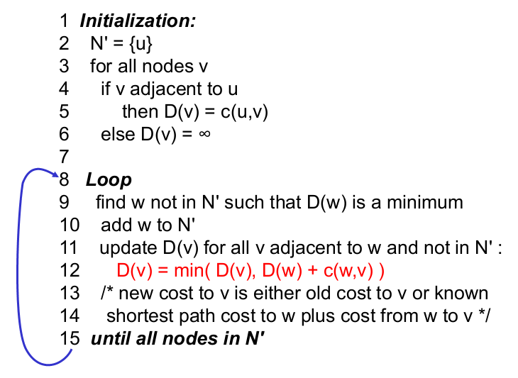
Dijsktra’s Algorithm

Slide 44
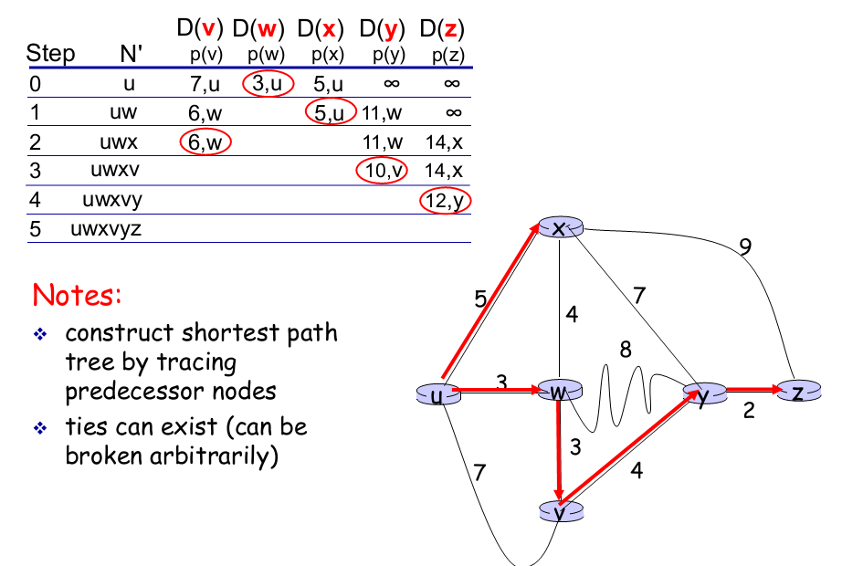
Dijkstra’s algorithm: example

Slide 45
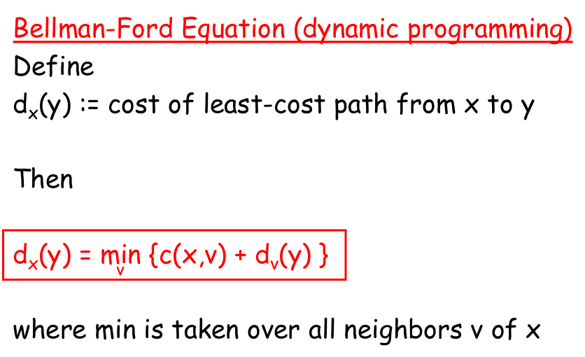
Distance Vector Algorithm

Slide 46
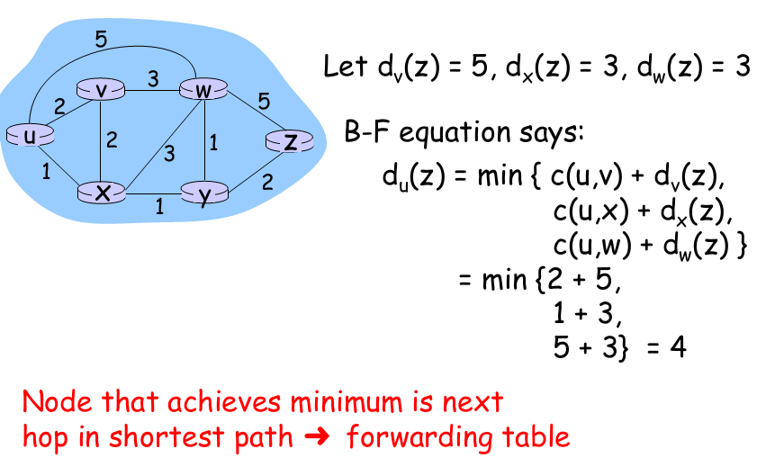
Bellman-Ford example

Slide 47
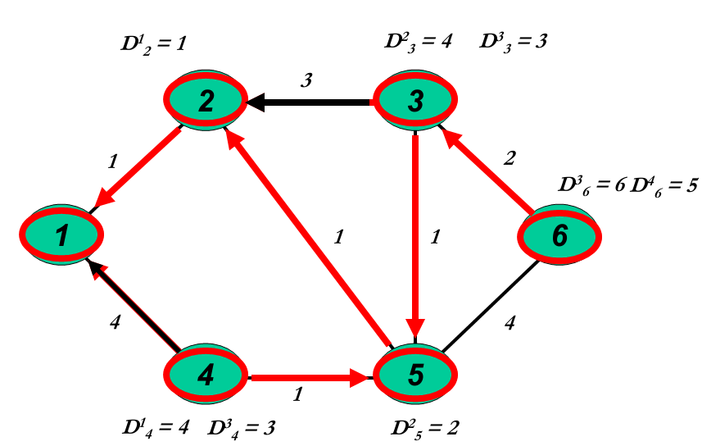
Finding Shortest Path to Node 1

Slide 48
Comparison of LS and DV algorithms
Message complexity
❖ LS: with n nodes, E links,
O(nE) msgs sent
❖ DV: exchange between
neighbors only
▪ convergence time varies
Speed of Convergence
❖ LS: O(n
2
) algorithm requires
O(nE) msgs
▪ may have oscillations
❖ DV: convergence time varies
▪ may be routing loops
▪ count-to-infinity problem
Robustness: what happens
if router malfunctions?
LS:
▪ node can advertise
incorrect link cost
▪ each node computes only
its own table
DV:
▪ DV node can advertise
incorrect path cost
▪ each node’s table used by
others
• error propagate thru
network

Slide 49
Hierarchical Routing
Our routing study thus far - idealization
❖ all routers identical
❖ network “flat”
… not true in practice
scale: with 200 million
destinations:
❖ can’t store all dest’s in
routing tables!
❖ routing table exchange
would swamp links!
administrative autonomy
❖ internet = network of
networks
❖ each network admin may
want to control routing in its
own network

Slide 50
Hierarchical Routing
❖ aggregate routers into
regions, “autonomous
systems” (AS)
❖ routers in same AS run
same routing protocol
▪ “intra-AS” routing
protocol
▪ routers in different AS
can run different intra-
AS routing protocol
gateway router
❖ at “edge” of its own AS
❖ has link to router in
another AS

Slide 51
Internet inter-AS routing: BGP
❖ BGP (Border Gateway Protocol): the de facto
inter-domain routing protocol
▪ “glue that holds the Internet together”
❖ BGP provides each AS a means to:
▪ eBGP: obtain subnet reachability information from
neighboring ASs.
▪ iBGP: propagate reachability information to all AS-
internal routers.
▪ determine “good” routes to other networks based on
reachability information and policy.
❖ allows subnet to advertise its existence to rest of
Internet: “I am here”

Slide 52
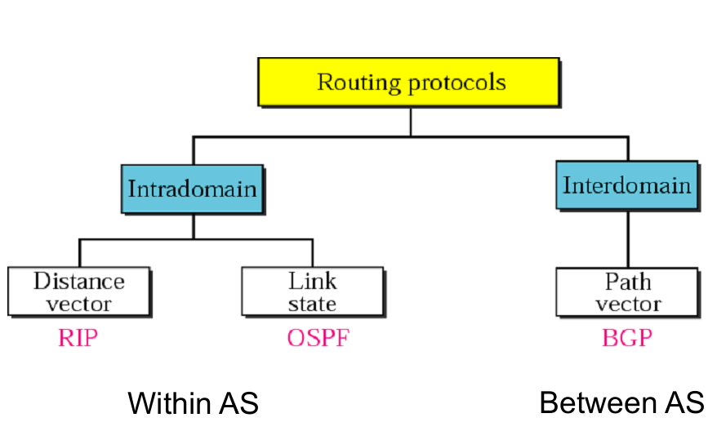
Summary

